Slide 1


LASI Physical Environment Data Linkage
April 11, 2024
Emma Nichols and Aidan Cole
g2aging.org

Slide 2
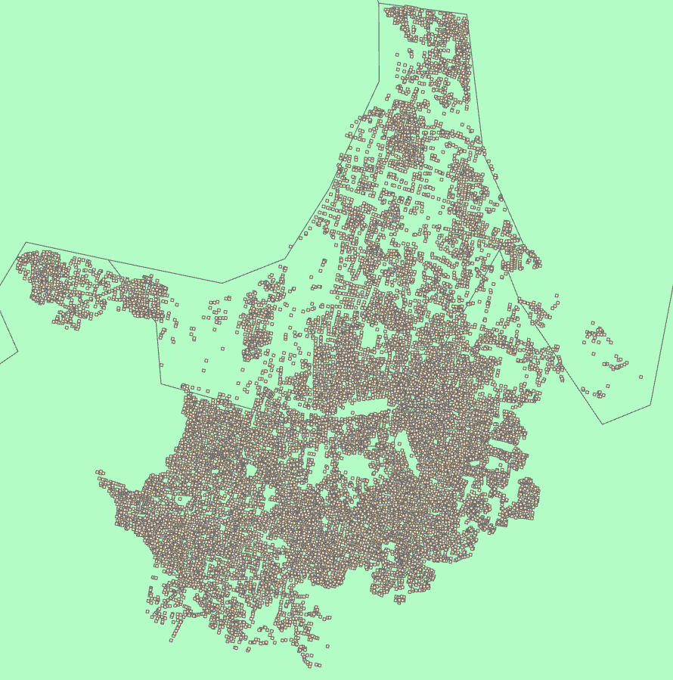
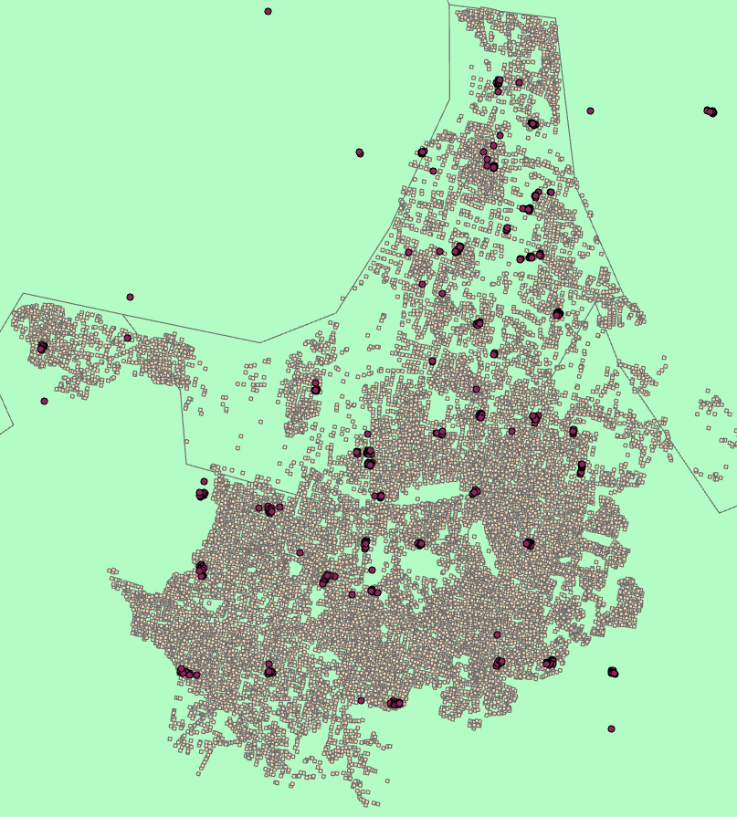
Data Description
The physical environment data that we are using was provided to us from the University of Minnesota team. This data was derived from Google OSM intersection images and includes object instance (number of people, cars, trucks, bicycles, etc. within intersection) and image segmentation (percent of intersection image that is greenspace, road, sidewalk, sky, etc.) data.
Kolkata intersections
LASI households in and near Kolkata

Slide 3
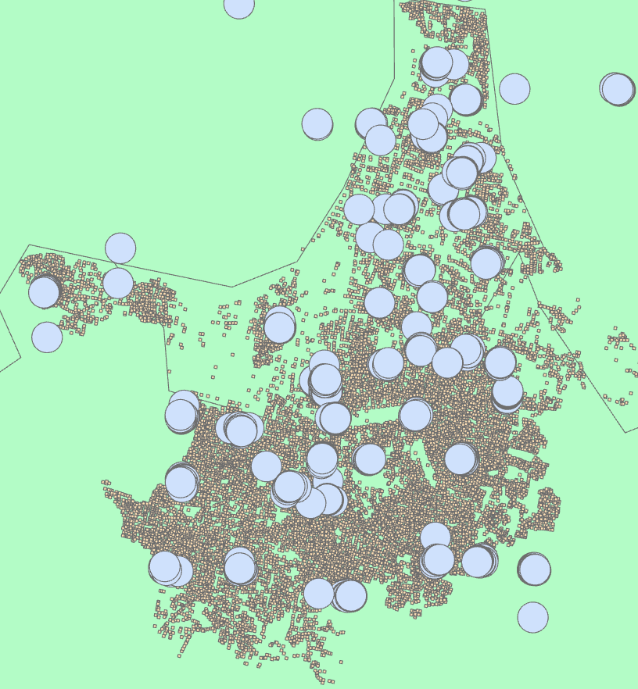
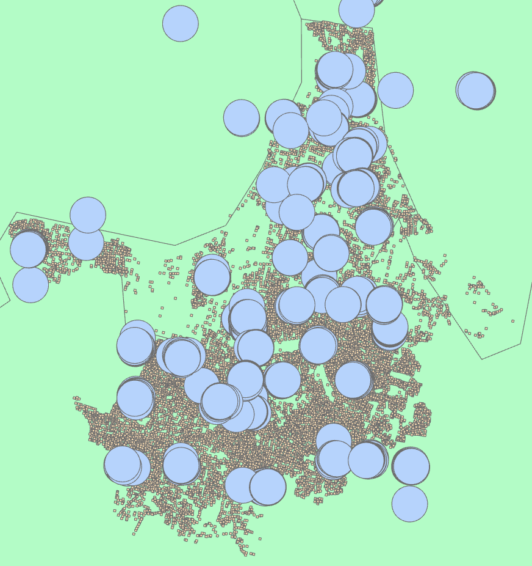
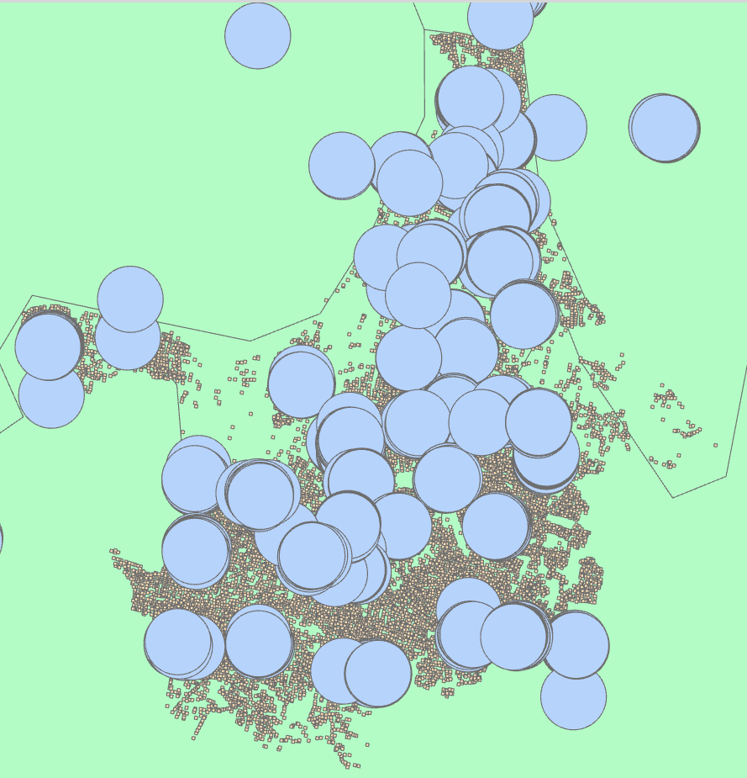
Buffer Methodology
To link OSM intersection data with LASI, we create buffers around each LASI household and summarize the information of all intersections within said buffers
500 m
750 m
1000 m
We decided to use the 500m (~1/3 mile) buffer because this distance provides a general idea of what the household’s neighborhood is like and because we want to make sure that households from outside of the OSM data’s extent are not included within analysis

Slide 4
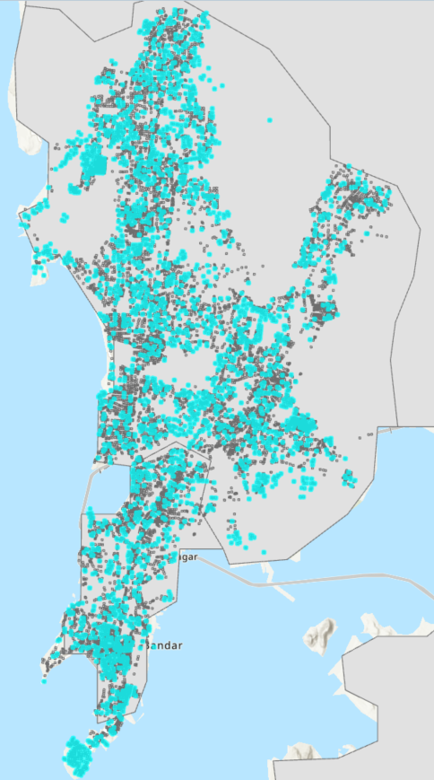
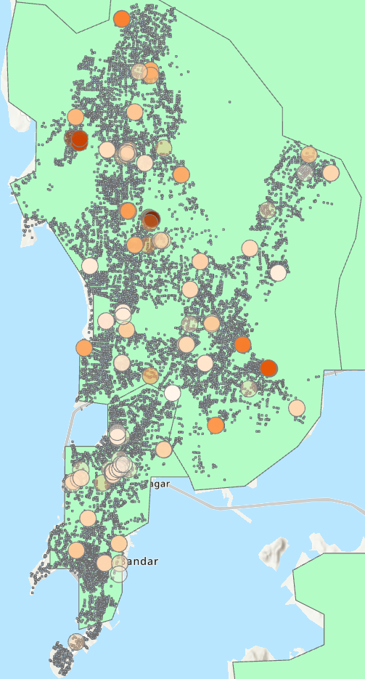
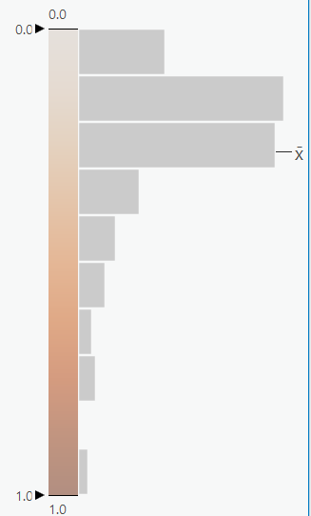
Spatial Orientation and Missing Data: Mumbai
Highlighted blue intersections have no object or segmentation data

Slide 5
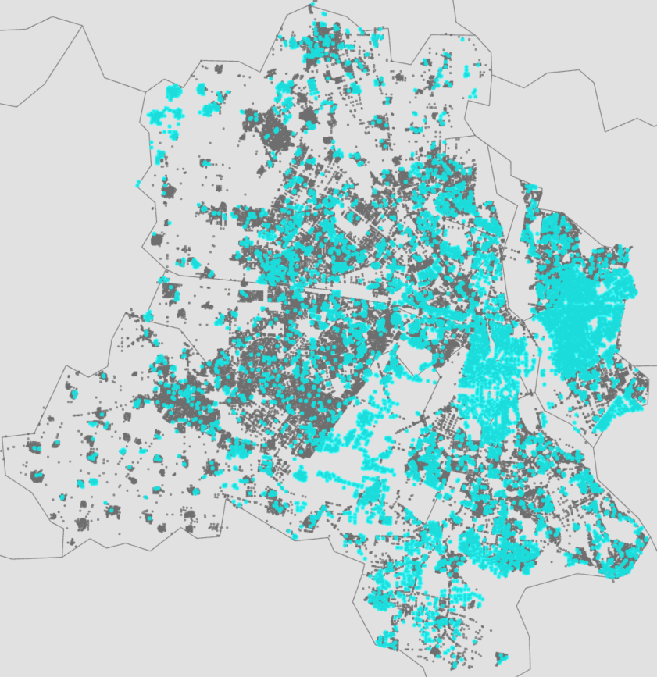
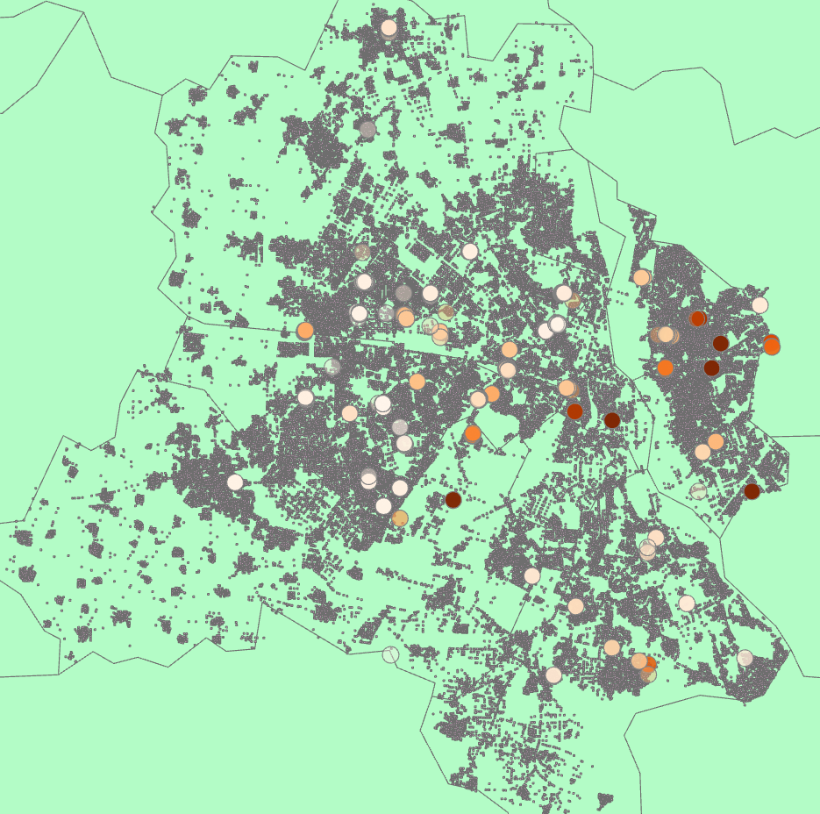
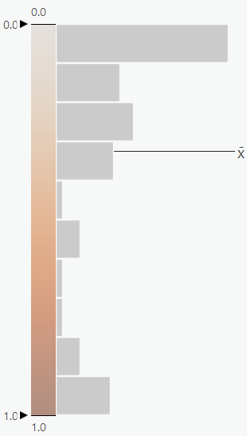
Spatial Orientation and Missing Data: Delhi

Slide 6
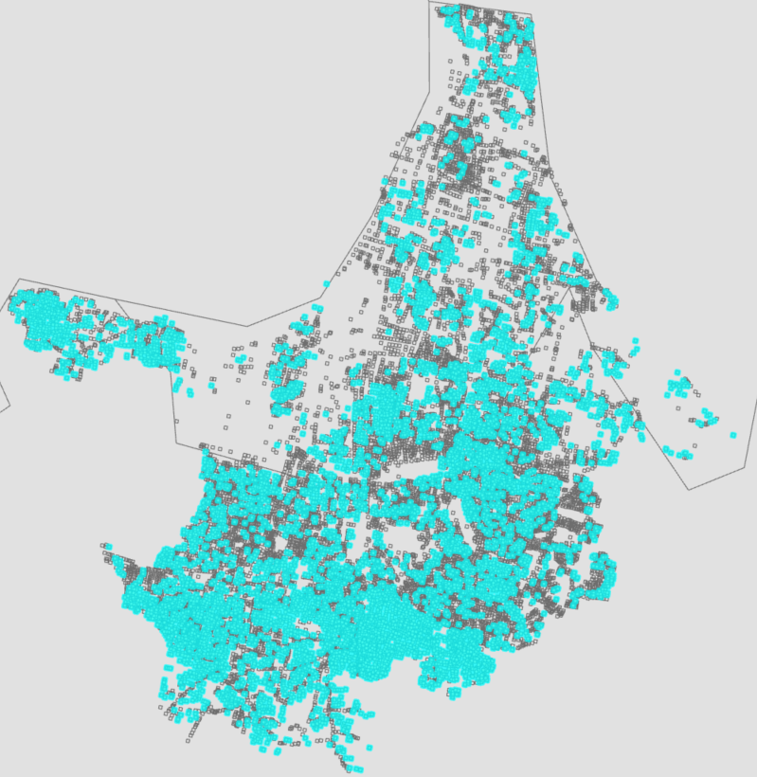
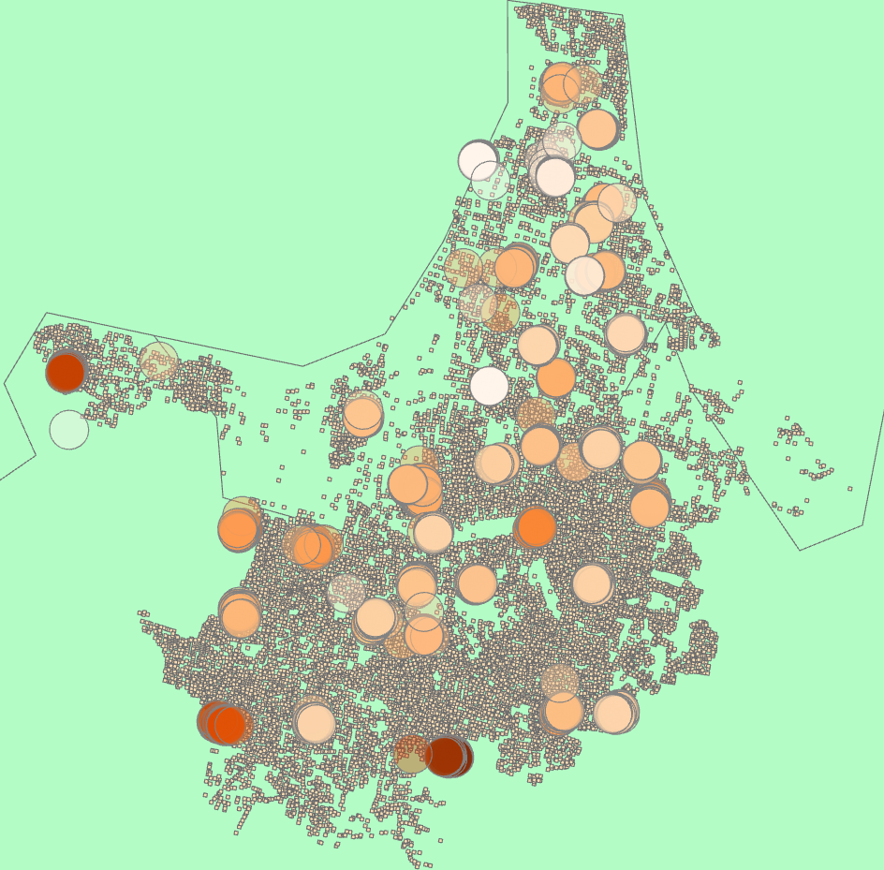
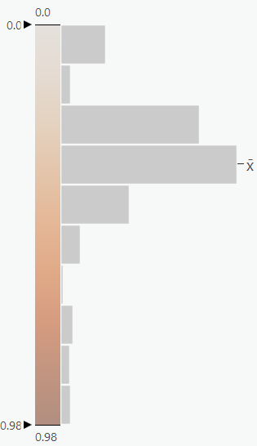
Spatial Orientation and Missing Data: Kolkata

Slide 7
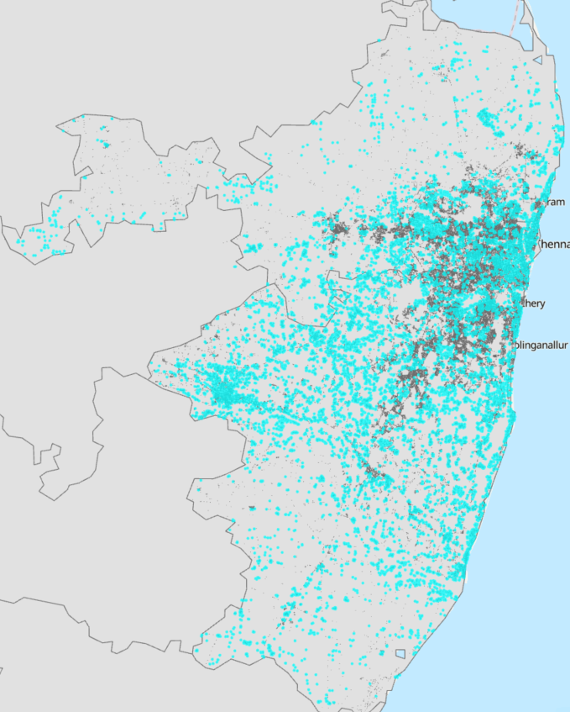
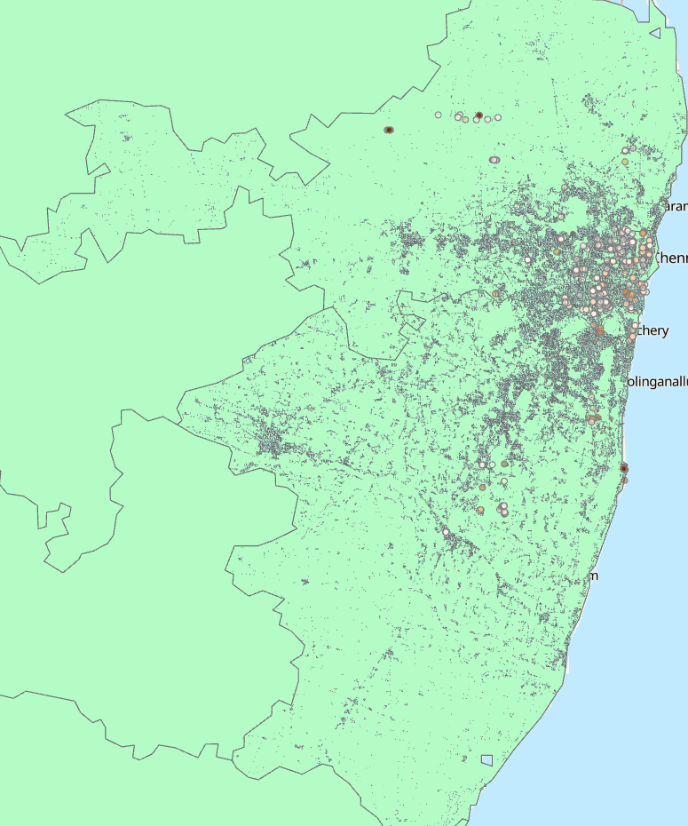
Spatial Orientation and Missing Data: Chennai
Chennai, missing intersections zoomed-out

Slide 8
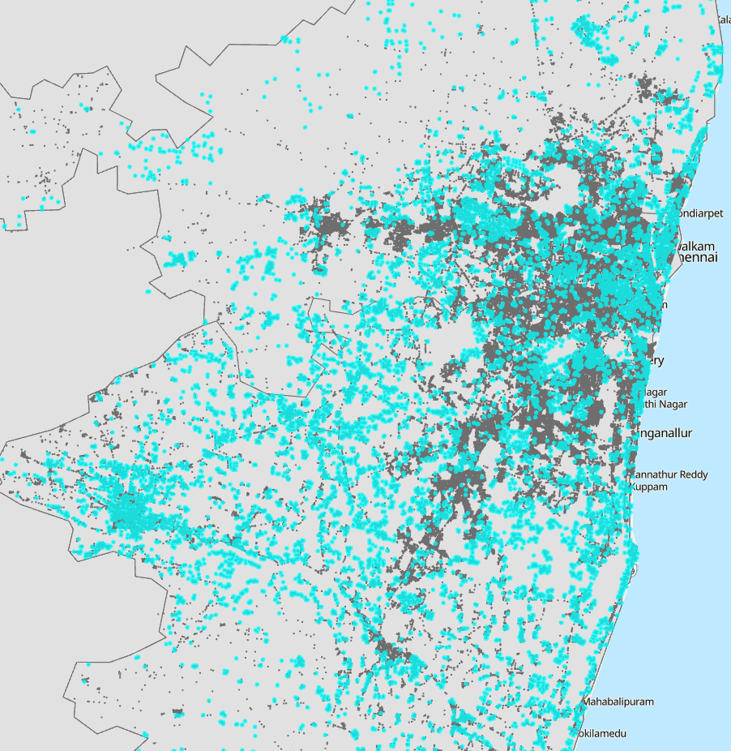
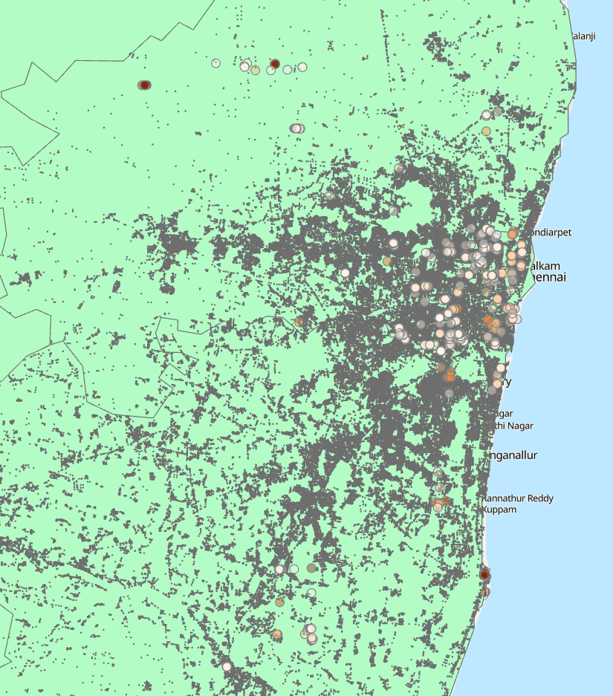
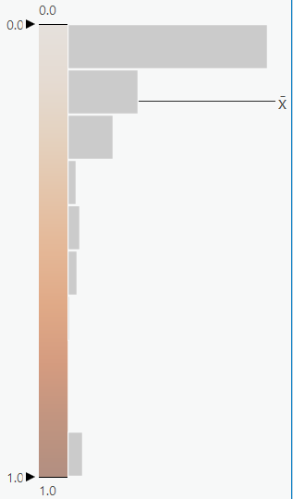
Spatial Orientation and Missing Data: Chennai
Chennai, missing intersections zoomed-in
Notes:
This is an extra one for the close-up Chennai.

Slide 9
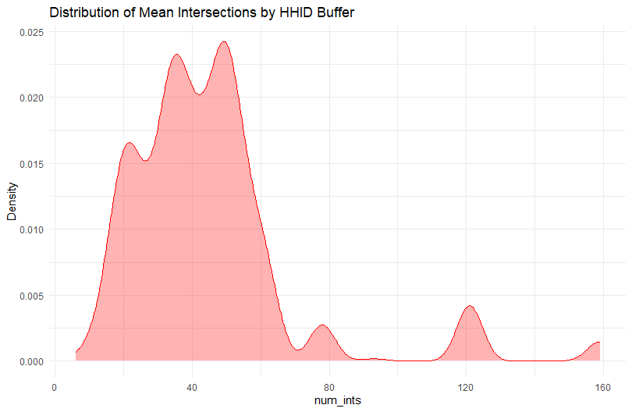
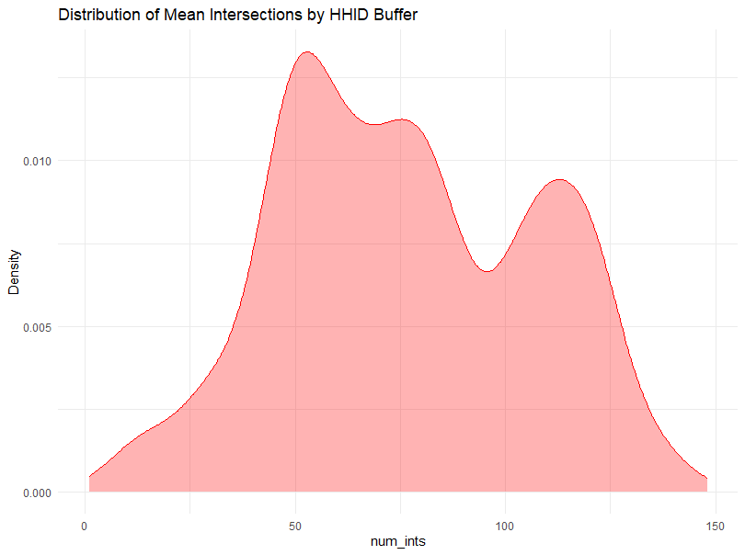
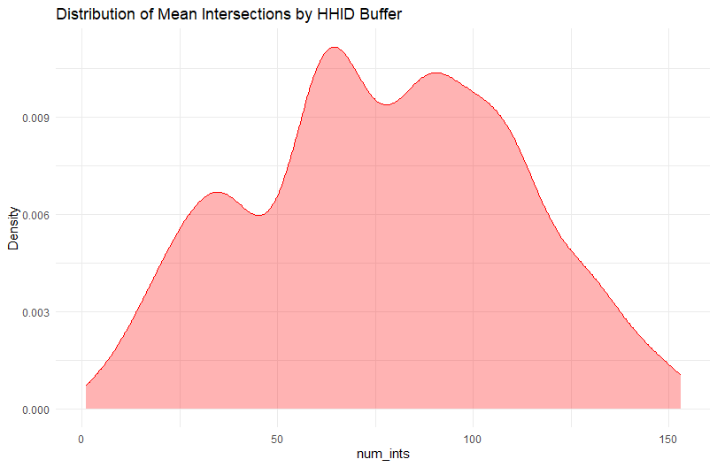
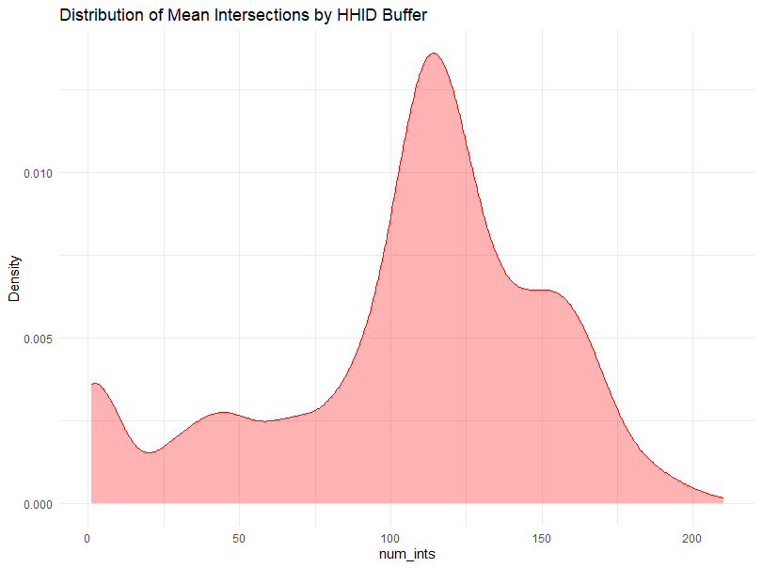
Mumbai
Delhi
Kolkata
Chennai

Slide 10
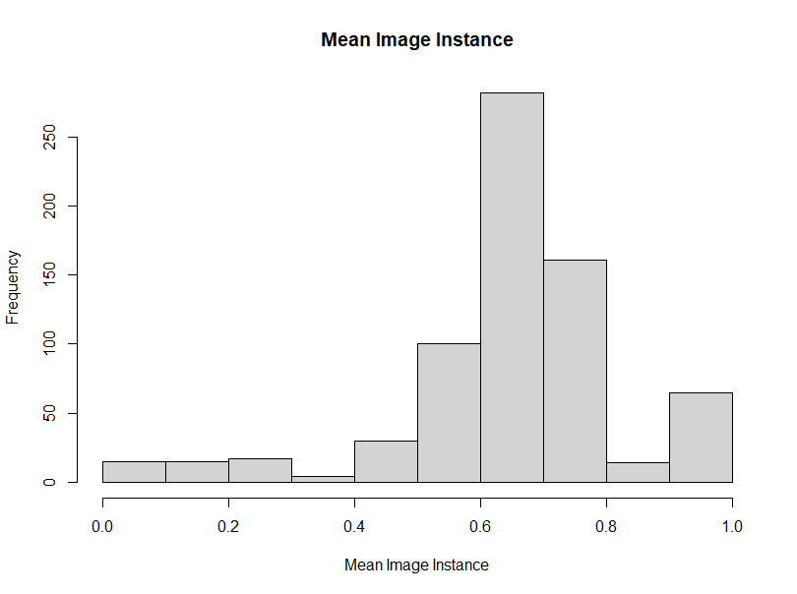
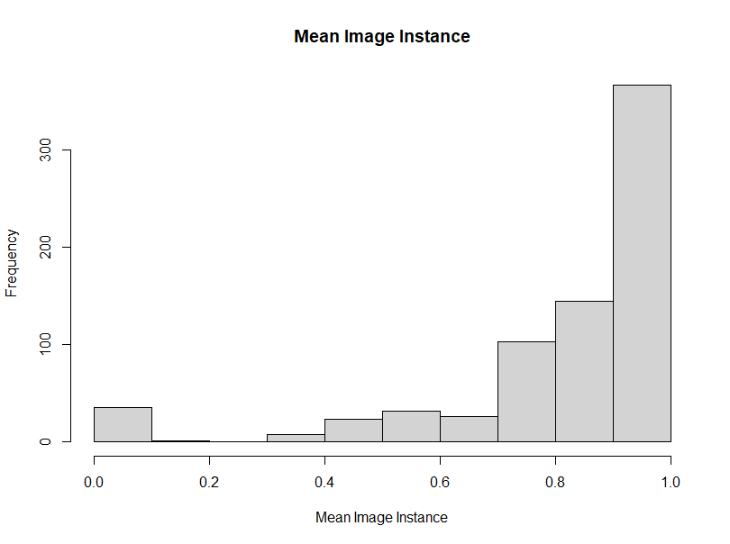
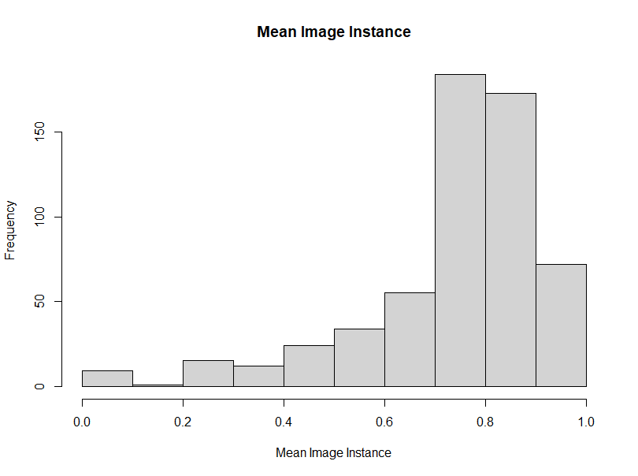
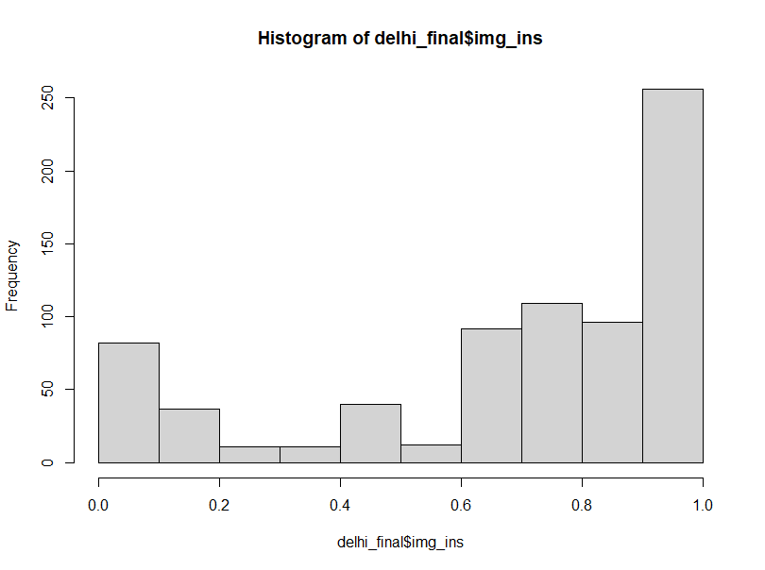
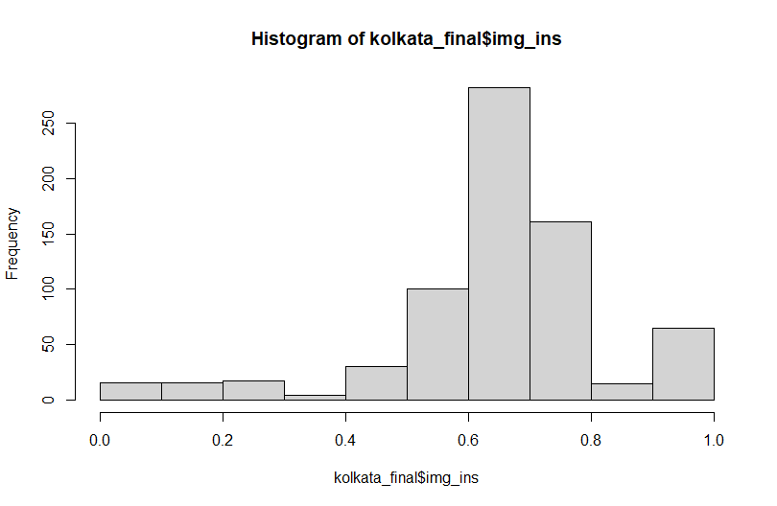
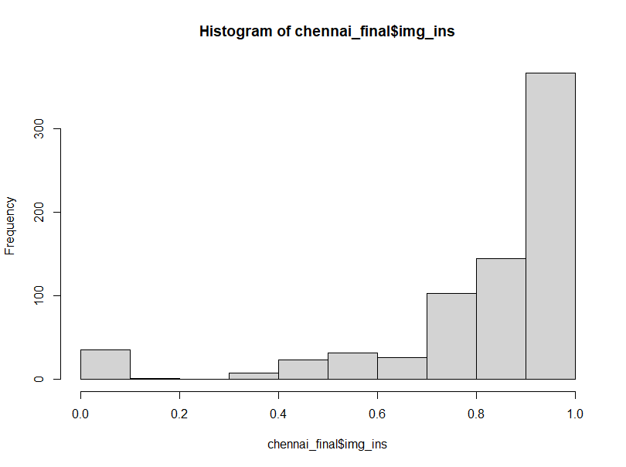
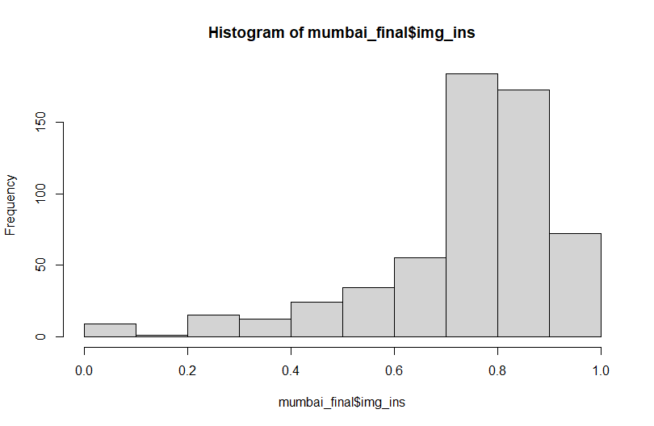

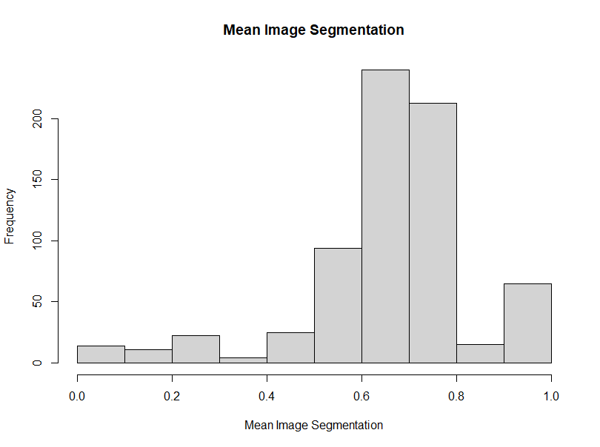
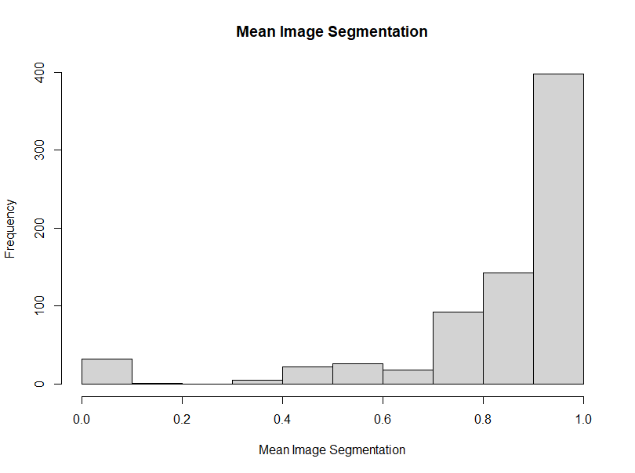
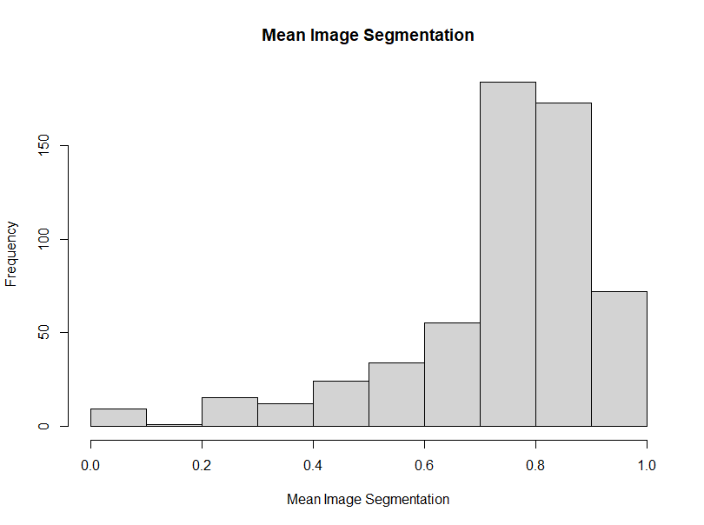
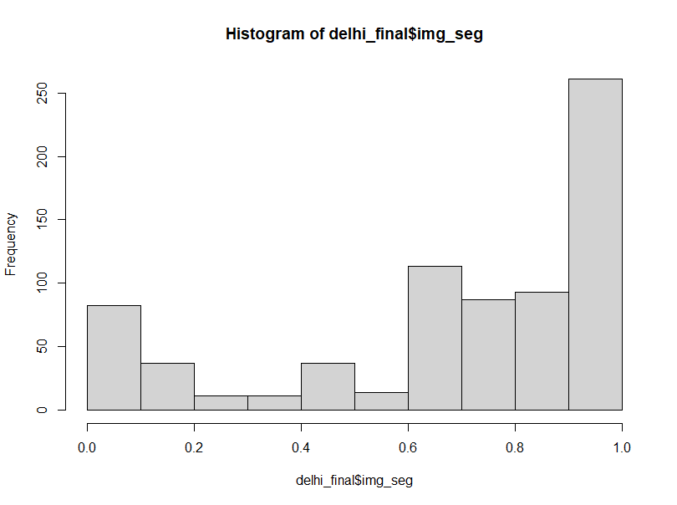
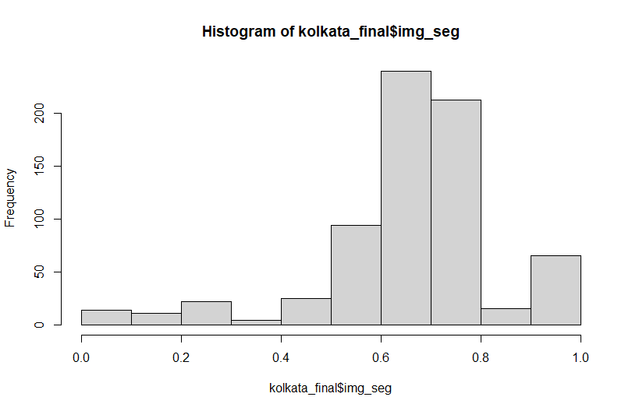
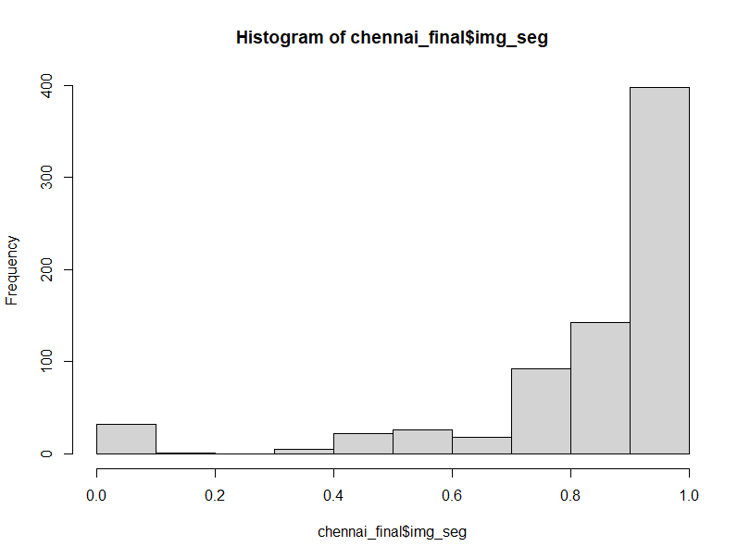


Mumbai
Delhi
Kolkata
Chennai
*top row image instance, bottom row image segmentation

Slide 11
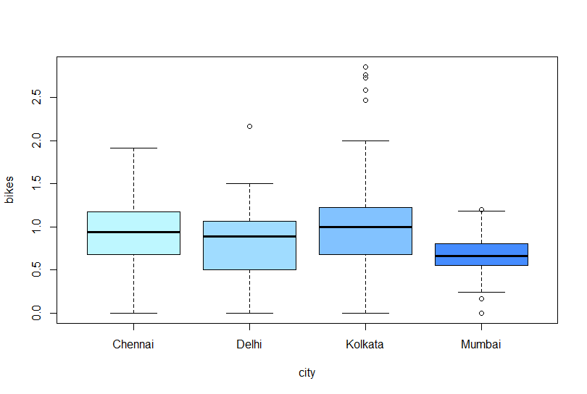
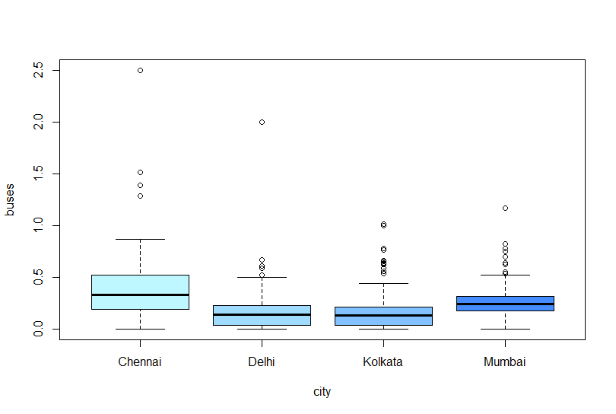
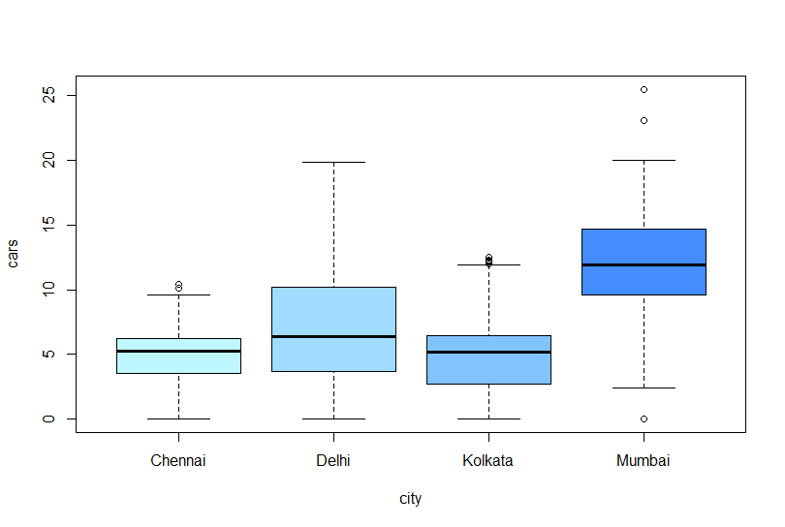
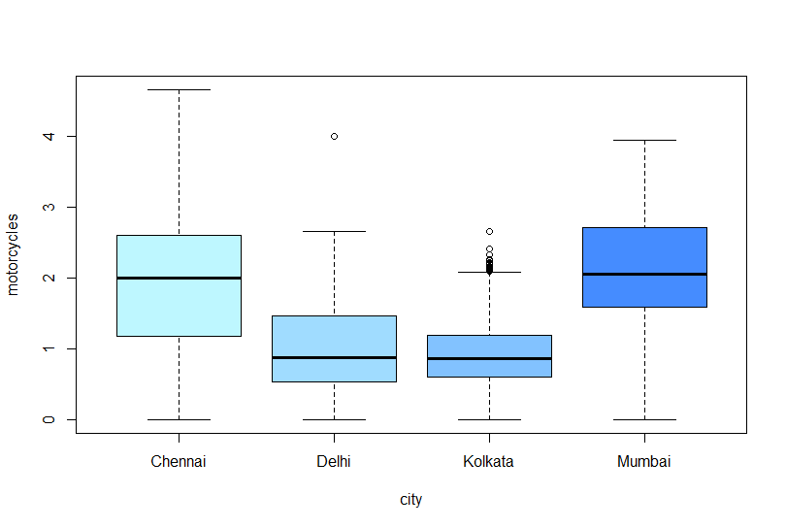
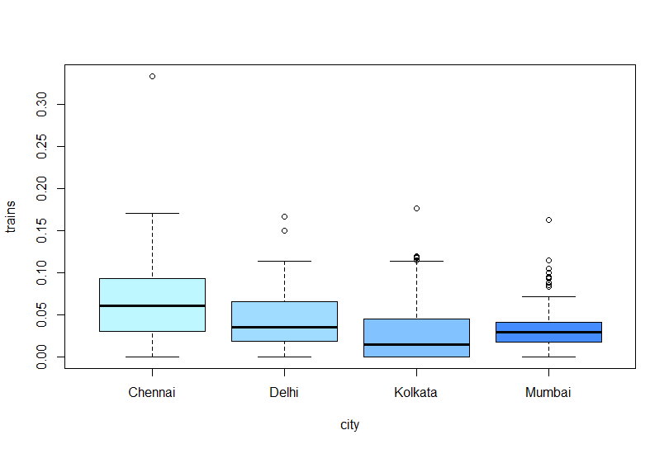
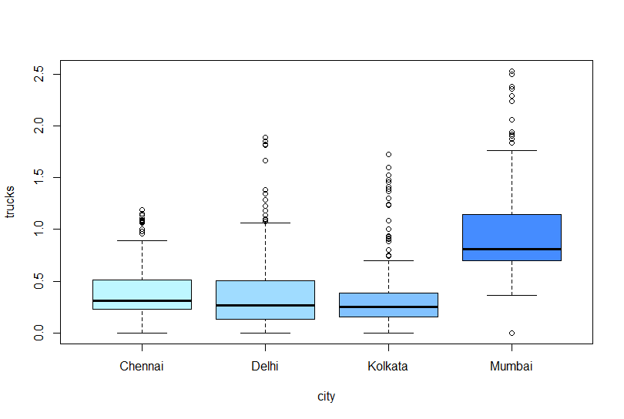
Vehicle Boxplots
Bikes
Buses
Cars
Motorcycles
Trains
Trucks

Slide 12
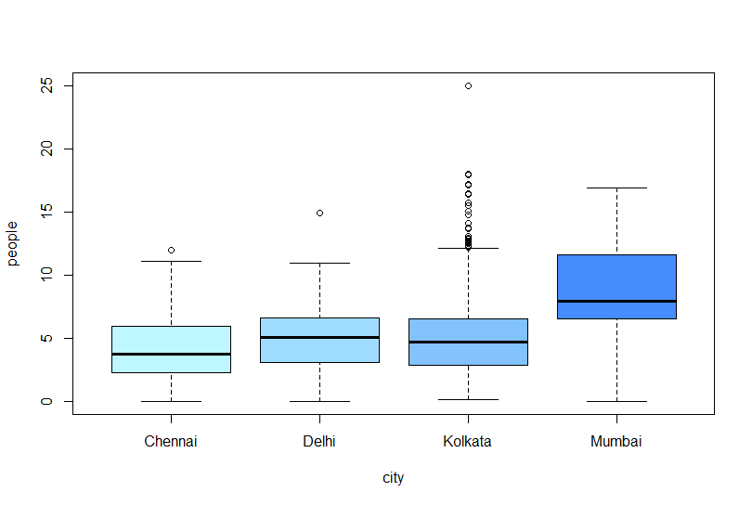
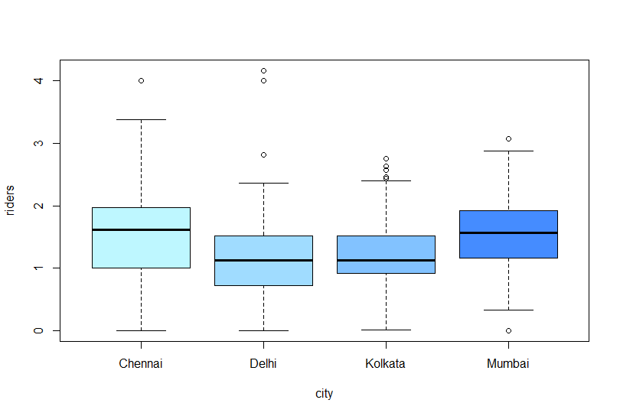
People Boxplots

Slide 13
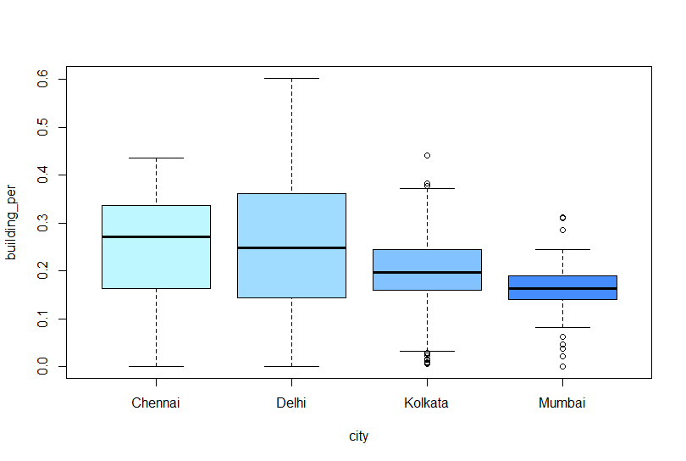
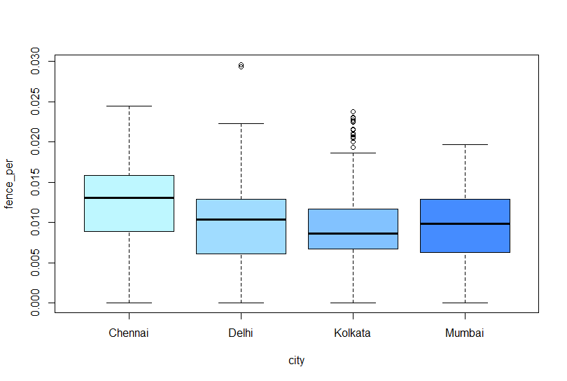
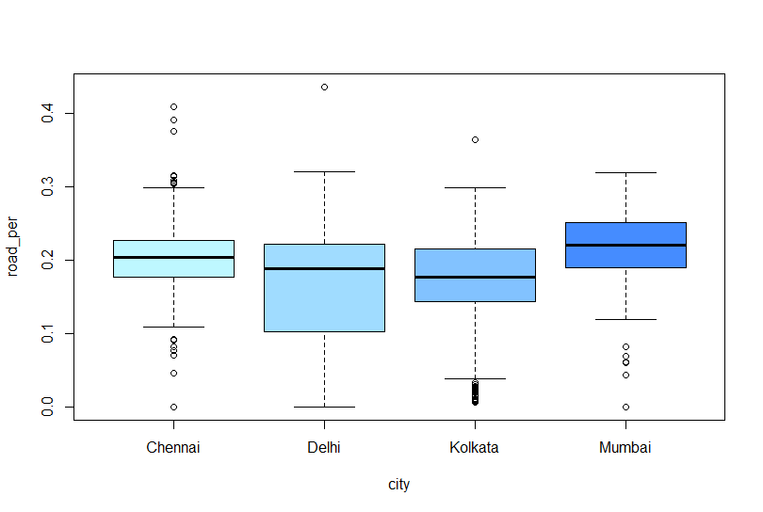
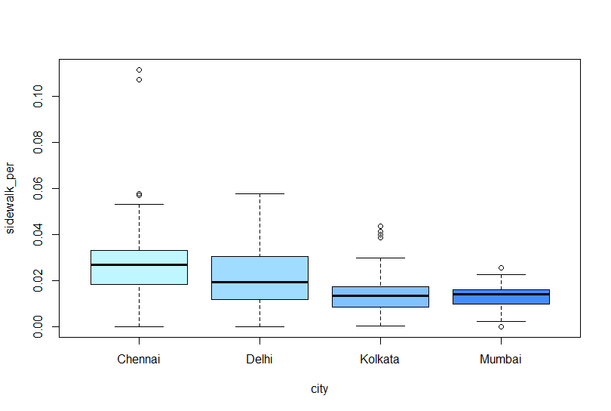
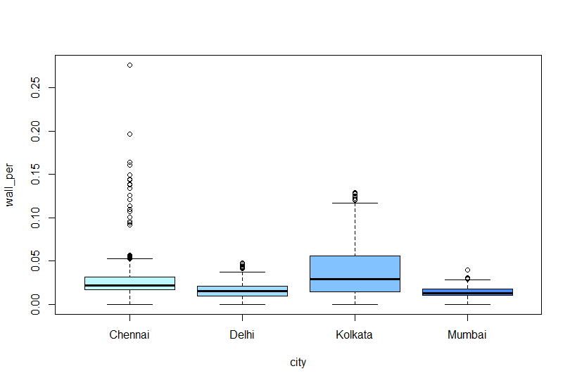
Percent Boxplots
% building
% fence
% road
% sidewalk
% wall

Slide 14
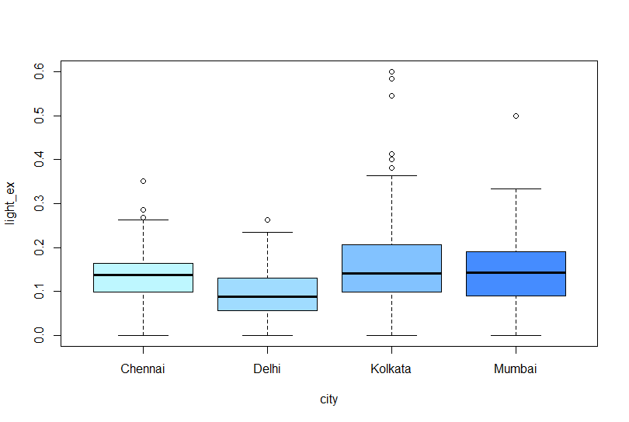


Exist Boxplots

Slide 15

GVI Boxplot

Slide 16




Mumbai
Delhi
Kolkata
Chennai

Slide 17
Continuing Work
Merge information from LASI core and community surveys
Validate data
Satellite-based greenspace vs GVI
Number of vehicles vs NO2 quartile
Number of vehicles vs Volume of traffic
Number of riders and pedestrians vs Quality of sidewalks and Volume of foot traffic
Associations with SES
Examine patterns across caste, education, parental education, literacy, consumption quintile
Look at association between % NA and SES (t-tests, chi-squared)

Slide 18
Thank You

